Slide 1

Forecast of Household Electricity Demand

Slide 2
Contents
Context
Dataset
LSTM
ARIMA
Visualizations
References

Slide 3
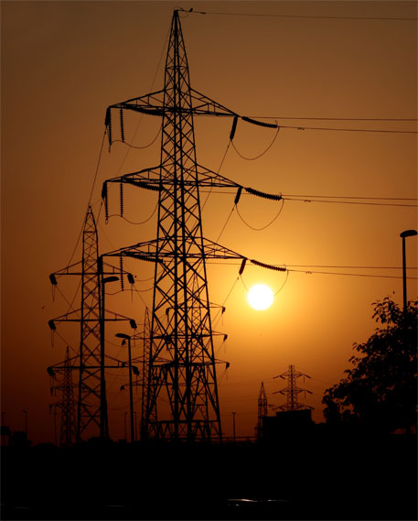
Context
India – 3rd the biggest producer and consumer of electricity in the world.
As of March 31, 2020, the electricity generation of India's national electric grid was 370.106 GW.
Large hydropower facilities are included in the category of renewable power plants, which make up 35.86% of generation capacity in India.
The gross power produced by utilities in India for the 2018–19 fiscal year was 1,372 TWh, and the nation as a whole (utilities and non–utilities) produced 1,547 TWh.
2018–19 had a gross power consumption of 1,181 kWh per person.

Slide 4
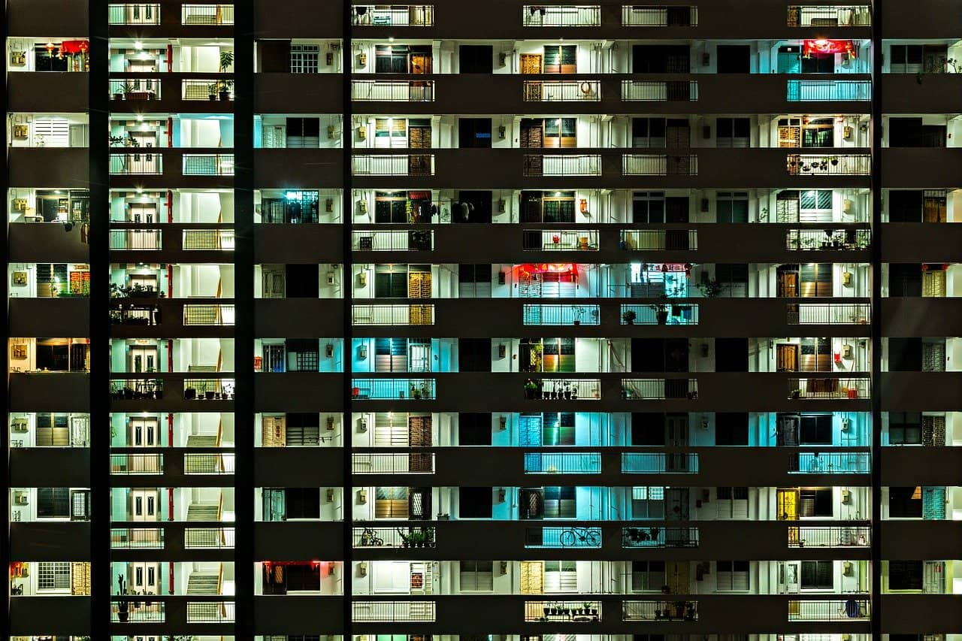
Context
Agriculture had the largest recorded global electric energy use (17.89 percent) in 2015–16.
Despite India's low electricity rate, its per capita electricity usage is low compared to that of the majority of other nations.
Every sector has seen the effects of the lockdown on economic activity as a result of the recent COVID-19 emergency, during which everyone was placed under lockdown for the months of April and May.
We developed a plan to research the influence on energy consumption state and region-wise due to the importance of power consumption to the nation.

Slide 5
Dataset
The dataset provides a comprehensive illustration of energy use at the state level. The 17-month time span between the 2nd of January 2019 and the 23rd of May 2020 is represented by content data in the form of a time series. Dates are used to index rows, and states are represented in columns. Together, the rows and columns of each datapoint represent the amount of electricity consumed in MU by the specified state on the mentioned date.

Slide 6
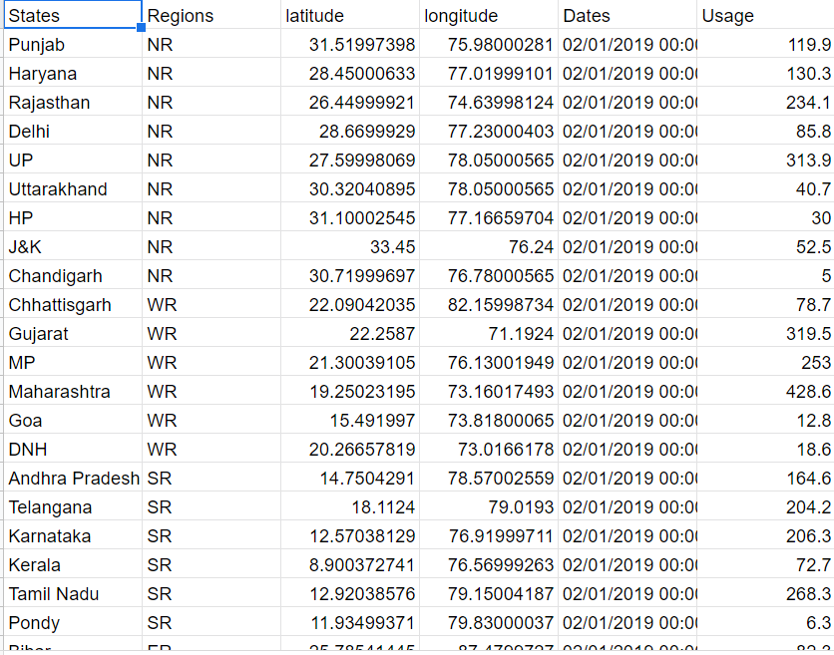
The Dataset

Slide 7
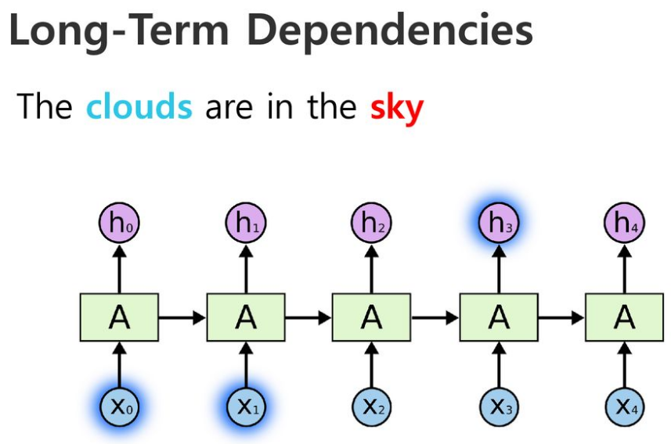
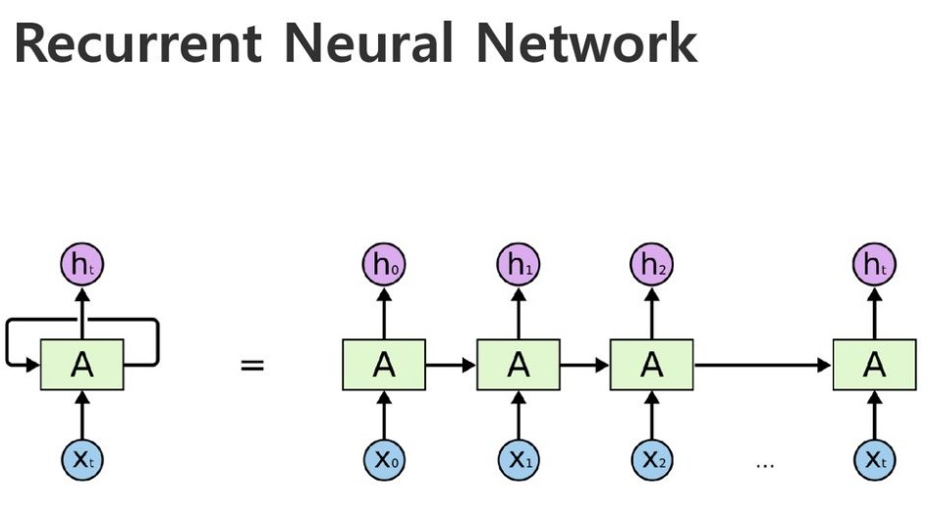
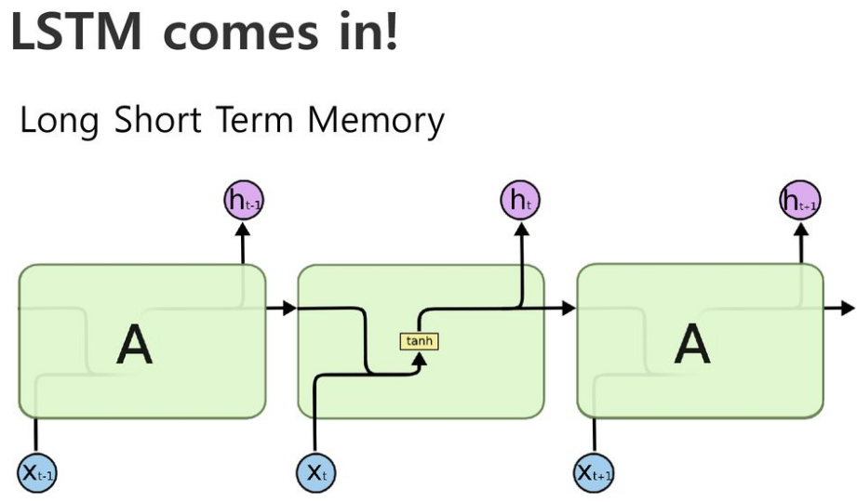
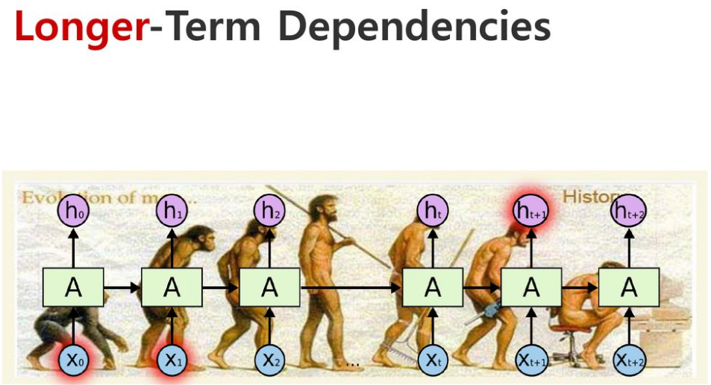
LSTM
This is just standard RNN

Slide 8
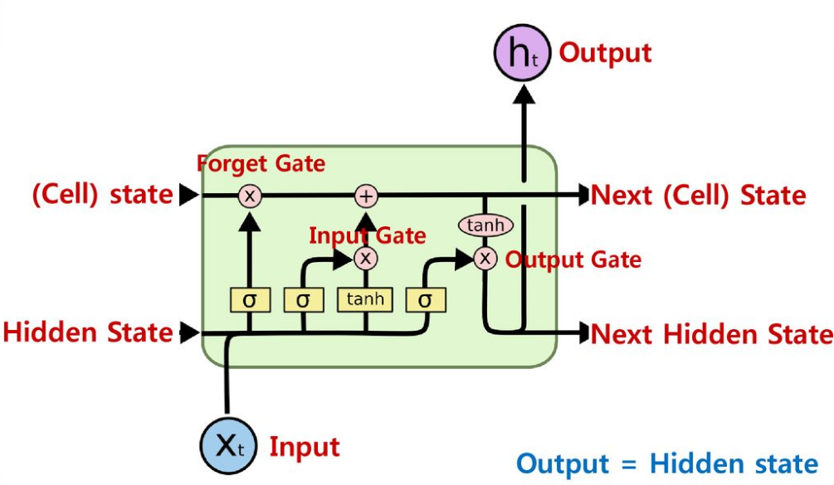
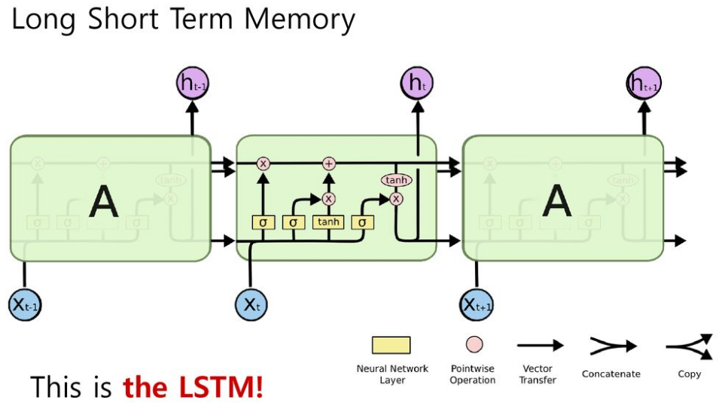
LSTM

Slide 9
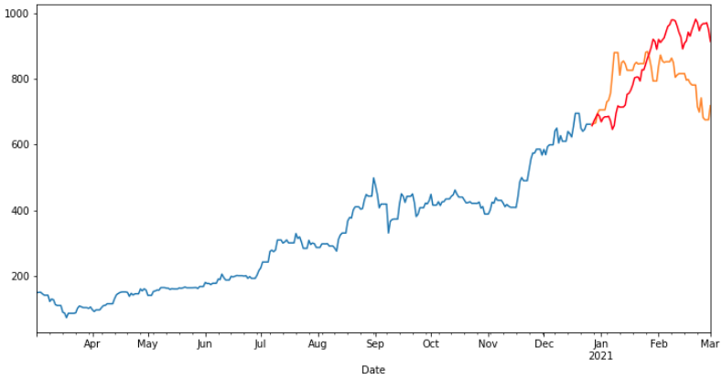
ARIMA
A simple autoregressive moving average (ARMA) model is generalized into an autoregressive integrated moving average (ARIMA) model. These two models are employed to forecast or predict upcoming time-series data points. Regression analysis in the form of ARIMA demonstrates the strength of a dependent variable relative to other variables varying factors.
By focusing on differences between series values instead of real amounts, the model ultimately aims to estimate future time series behavior. In situations when the data exhibits signs of non-stationarity, ARIMA models are used. Non-stationary data are always converted into stationary data in time series analysis.

Slide 10
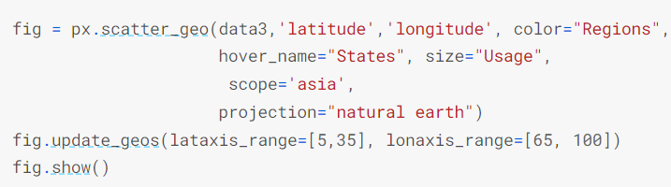
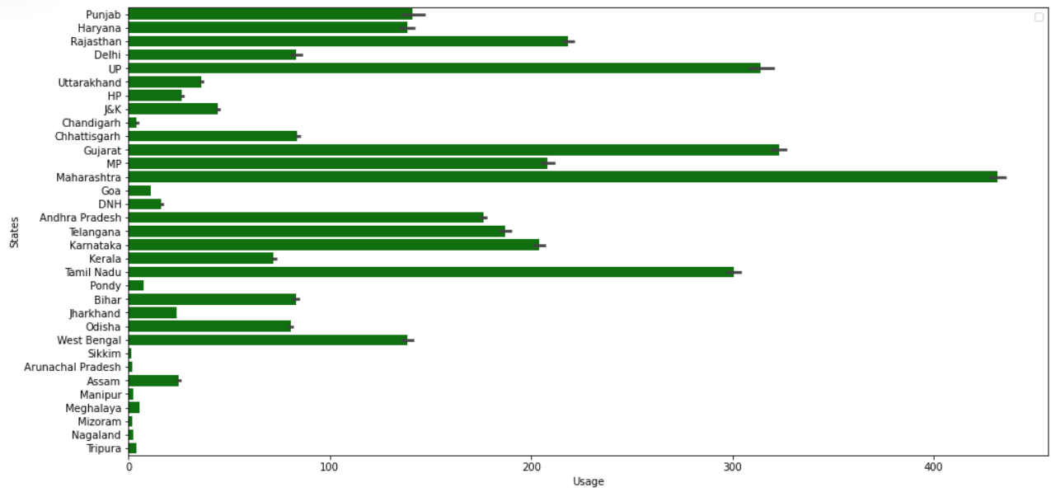
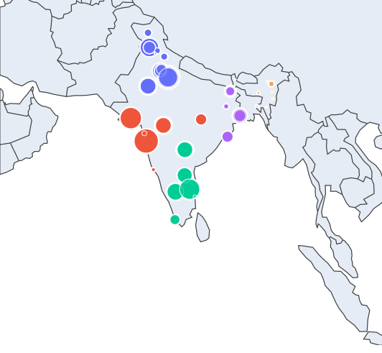
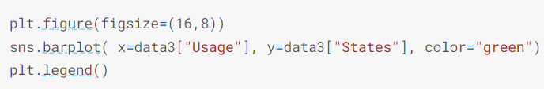
Visualizations

Slide 11

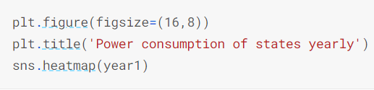
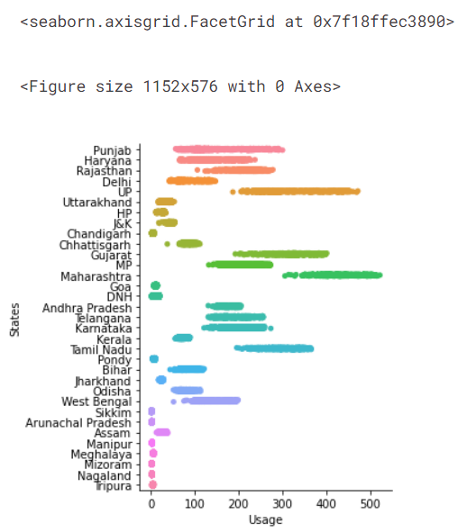
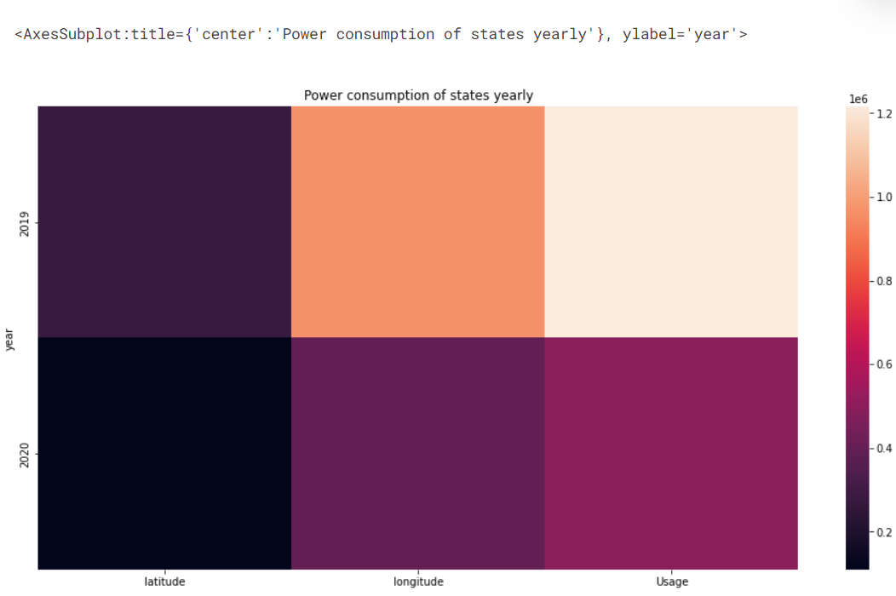
Visualizations

Slide 12
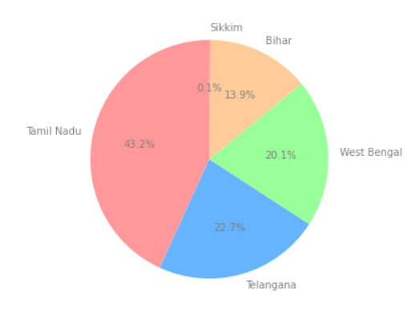
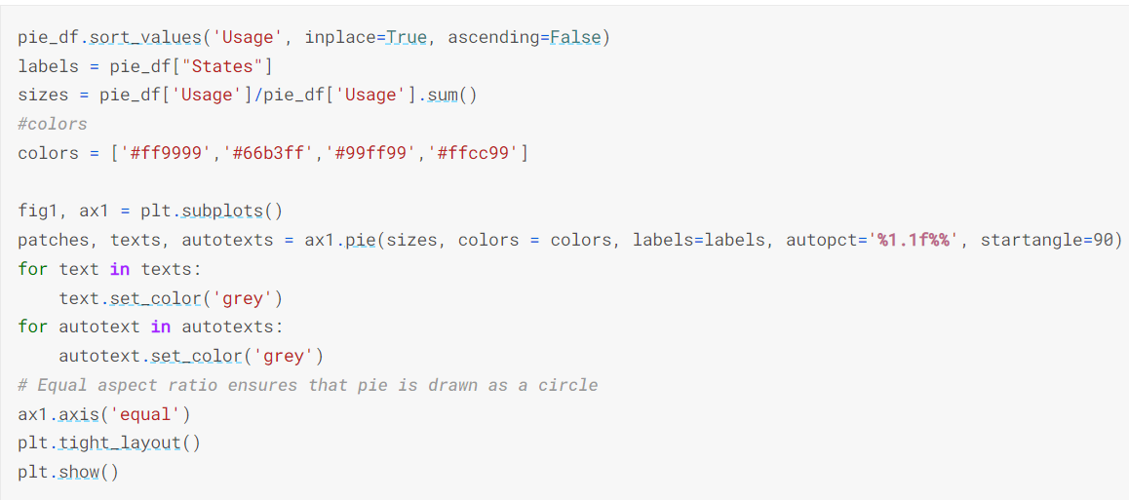
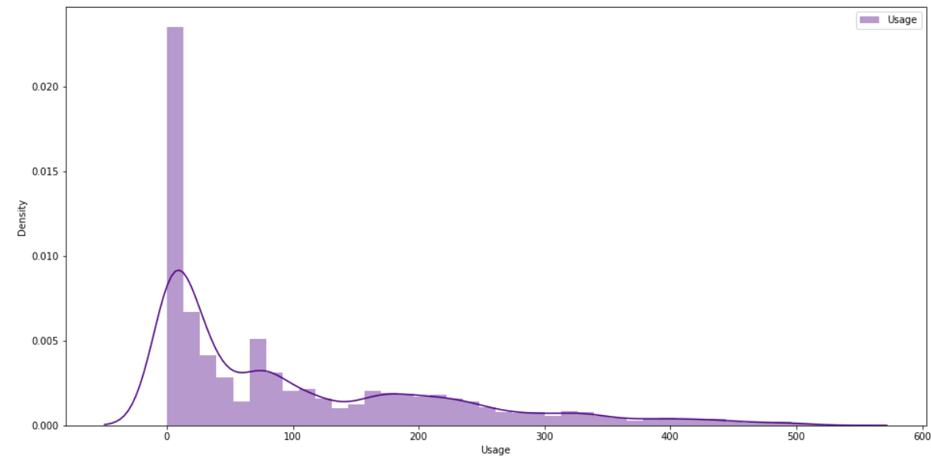
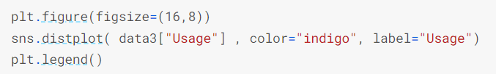
Visualizations

Slide 13
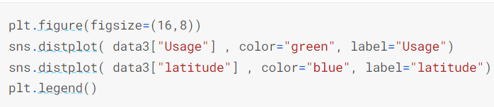

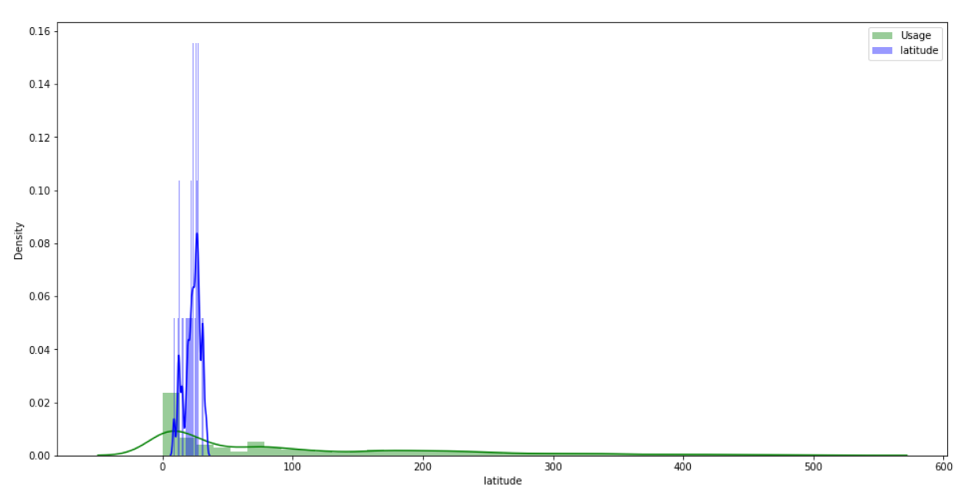
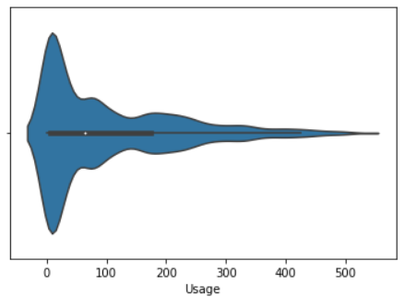
Visualizations

Slide 14
References
https://www.analyticsvidhya.com/blog/2021/11/performing-time-series-analysis-using-arima-model-in-r/
https://www.machinelearningplus.com/time-series/arima-model-time-series-forecasting-python/
https://www.analyticsvidhya.com/blog/2022/03/an-overview-on-long-short-term-memory-lstm/
https://www.geeksforgeeks.org/deep-learning-introduction-to-long-short-term-memory/
https://en.wikipedia.org/wiki/Long_short-term_memory#:~:text=Long%20short%2Dterm%20memory%20(LSTM,networks%2C%20LSTM%20has%20feedback%20connections.

Slide 15
Thank You!

